Slide 1



Software Testing
GRADUATION PROJECT
Supervised by Eng.John Nafady

Slide 2

The Testing Team
Ahmed Mohamed Negm
Rana Osama Hassan
Hussein Osama Elhusseini
Youstina Gamal Aziz

Slide 3
Agenda
INTRODUCTION
Testing SuiteCRM Demo Website
SUITECRM FEATURES
Steps of the Testing Process
Types of Testing
Test Case Execution Results
Priority Of Test Cases
Future Work
Conclusion

Slide 4


Introduction
Software Testing is all about finding defects before the software reaches users. It’s not just about proving everything works but uncovering hidden issues to prevent problems later. By testing, we aim to catch bugs early, improve performance, and ensure the software meets user needs. In the end, it ensures a smoother, more reliable experience for everyone.

Slide 5
Demo Overview
The demo website is a customer relationship management (CRM) that helps businesses manage sales, marketing and customer support.
Testing SuiteCRM Demo Website
Testing Objectives
The objective of testing the SuiteCRM demo is to identify and report any defects in the core functionalities, ensuring the system performs as intended. The focus is on verifying feature functionality and user experience. This helps ensure a reliable, user-friendly experience.

Slide 6
SuiteCRM Features
1
2
3
4
Sales Automation
Customer Support
Marketing Automation
Contact & Account Management
Track leads, opportunities, and manage the sales pipeline for efficient sales processes.
Case management to handle customer issues and service requests effectively.
Create and manage email campaigns, track leads, and enhance customer engagement.
Centralized storage for customer and organization details, ensuring seamless communication.

Slide 7
SuiteCRM Features
5
6
7
Reports & Dashboards
Workflow Automation
Customization & Integration
Customizable reports and real-time dashboards for insightful data analysis.
Automate repetitive tasks to increase efficiency and streamline operations.
Adapt the CRM to specific business needs and integrate with other applications.

Slide 8
Steps of the Testing Process
1
2
3
4
Requirement Analysis
Test Planning
Test Case Design
Environment Setup
Understand and analyze requirements for the application.
Identify testing requirements, goals, and objectives.
Define the testing scope, approach, and resources.
Create a test plan document outlining strategies, tools, and responsibilities.
Develop detailed test cases and scenarios based on requirements.
Ensure test cases are traceable, clear, and cover functional and non-functional requirements.
Prepare the testing environment, including hardware, software, and network configurations.
Ensure all dependencies are available and the environment resembles production.

Slide 9
Steps of the Testing Process
5
6
7
Test Execution
Defect Reporting & Tracking
Test Closure
Run the test cases as planned.
Log any defects or issues found and report results.
Document any defects found during testing.
Track and prioritize defects for resolution.
Analyze test coverage and effectiveness.
Document lessons learned and best practices for future projects.

Slide 10
Types of Testing
Unit Testing
Tests individual components or functions of the software.
Ensures each piece of code works as expected independently.
Integration Testing
Tests the interaction between integrated units or modules.
Focuses on data flow between modules to ensure they work together.

Slide 11
Types of Testing
System Testing
Tests the complete system as a whole.
Verifies that the system meets specified requirements.
Acceptance Testing
Conducted by end-users or stakeholders.
Determines if the system satisfies business requirements.

Slide 12
Types of Testing
Regression Testing
Tests the interaction between integrated units or modules.
Focuses on data flow between modules to ensure they work together.
Performance Testing
Tests the complete system as a whole.
Verifies that the system meets specified requirements.

Slide 13
Types of Testing
Security Testing
Checks the system for vulnerabilities to protect data and maintain functionality.
Includes penetration testing and vulnerability scanning.
Usability Testing
Focuses on user-friendliness and ease of use.
Evaluates the system’s interface and user experience.

Slide 14
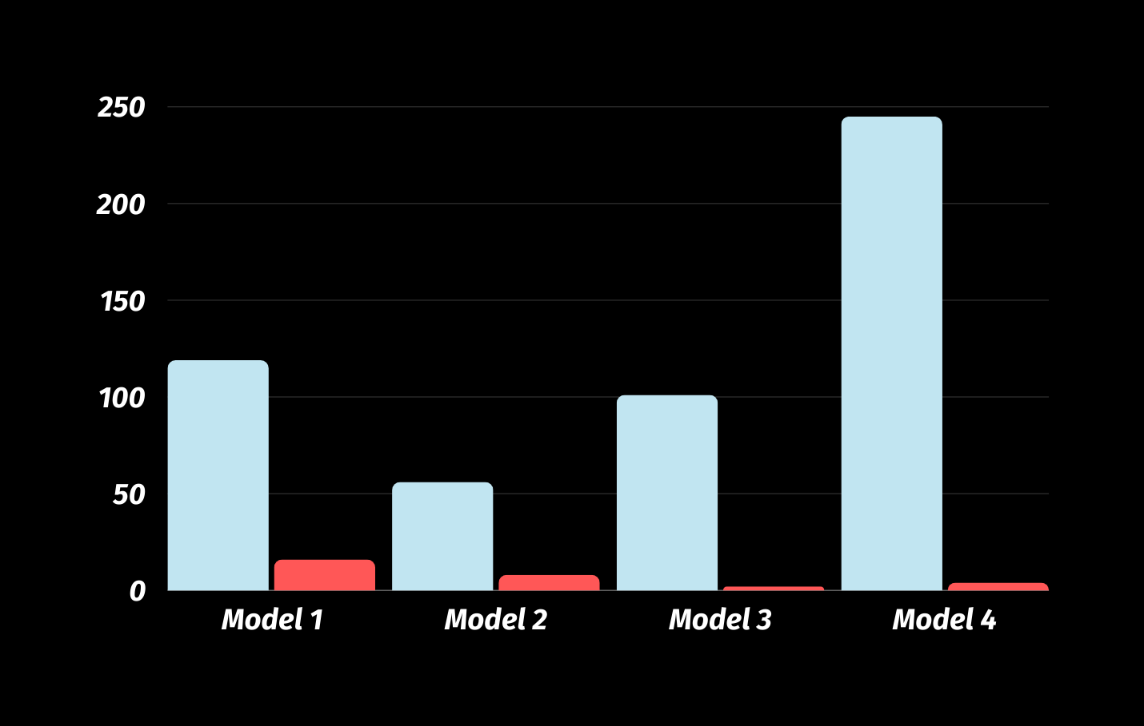
Test Case Execution Results
We wrote and executed 551 test cases.
are the outcomes of running predefined tests on a software application or system to verify its functionality and overall quality

Slide 15
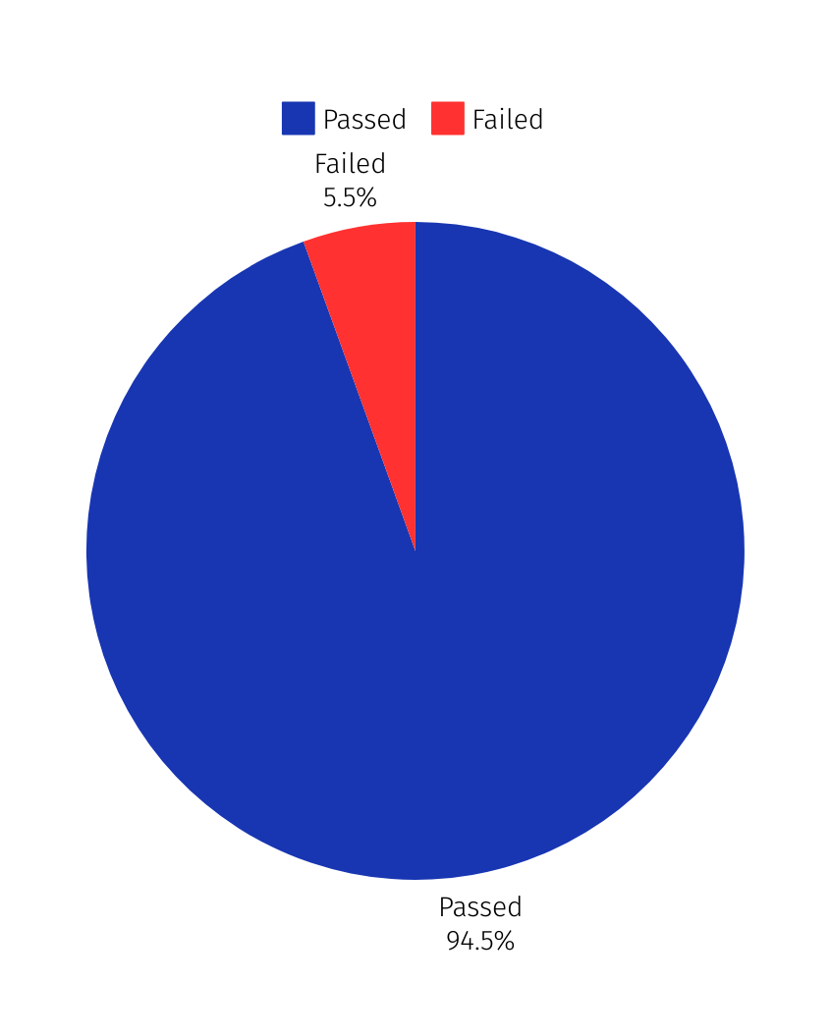
Percentage Of Failure
We found 30 Defects
We have divided our main sources into Two categories
Passed
Failed

Slide 16
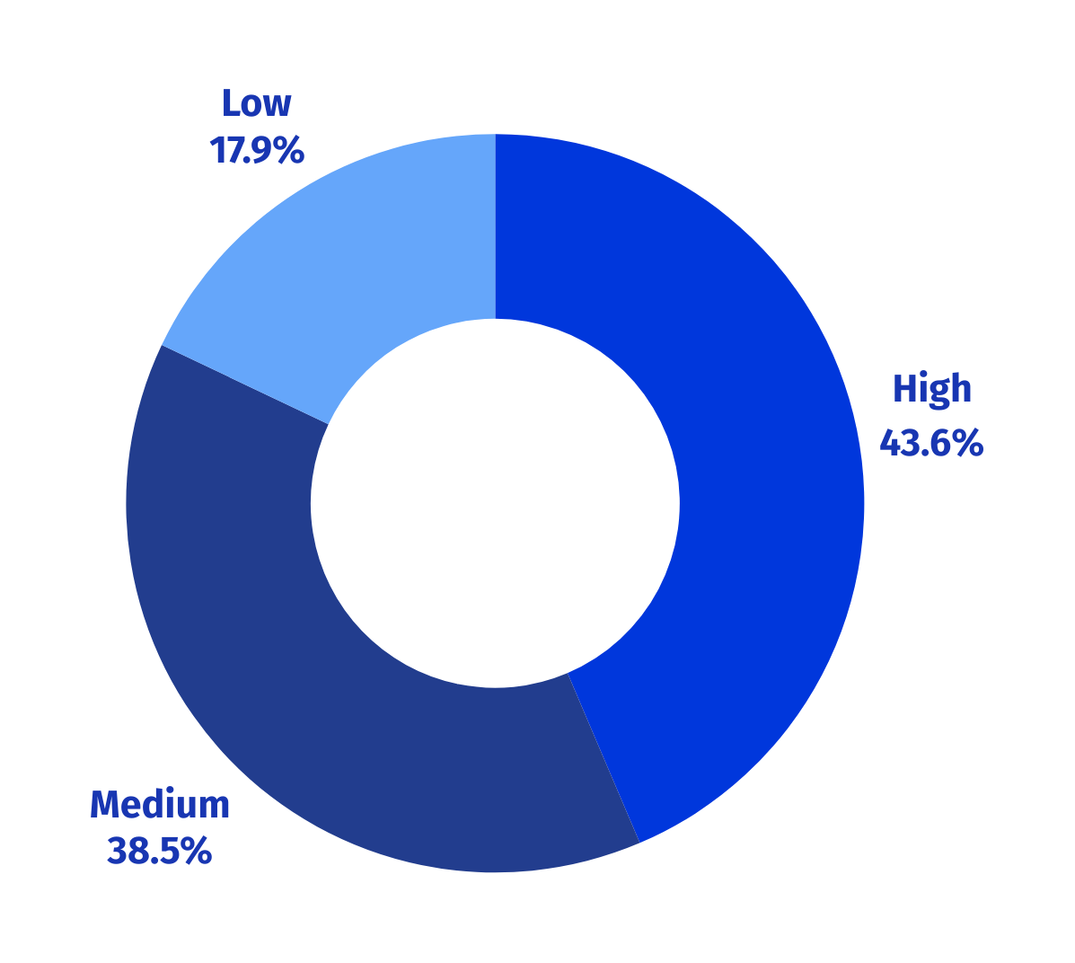
Priority Of Test Cases
We have divided Priorty of Test cases into Three categories
Critical Functionalities (High Priority)
Important Functionalities (Medium Priority)
Additional Functionalities (Low Priority)

Slide 17
Future Work: Automation Testing
Objective
Key Benefits
Action Plan
Transition to automation testing to enhance efficiency, accuracy, and test coverage.
Automation will save us time, especially for repetitive tests, allowing us to focus on more complex testing tasks.
It will help improve the accuracy of our tests and ensure we catch more issues early on.
We'll start using tools like Selenium for our automation efforts.
Focus on manual testing for exploring new areas while using automation for regular tests.

Slide 18
The SuiteCRM demo showcases strong features for managing customer relationships, despite some bugs that need fixing. Making necessary adjustments will enhance the overall experience. Integrating automation testing will further improve the platform's efficiency and reliability for businesses.
Conclusion

Slide 19
Thank you!
Feel free if you have any questions.

